Slide 1
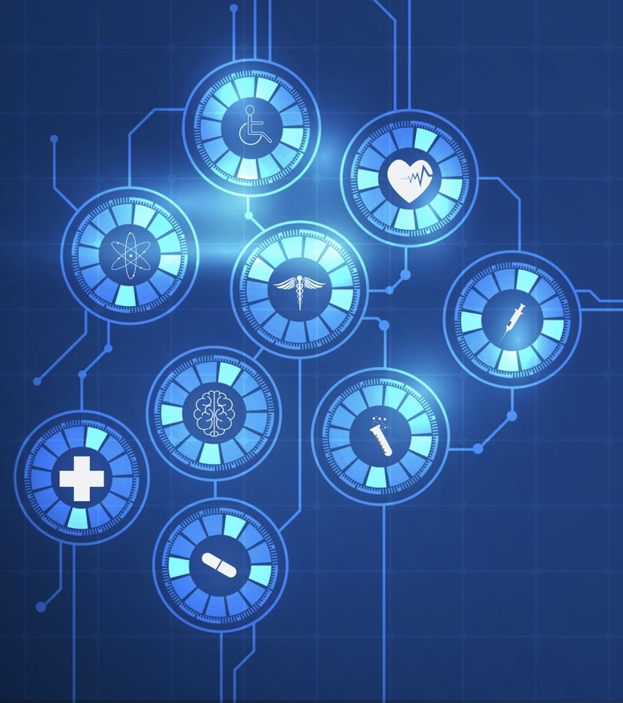
AlphaFold3 is All You Need ?
Malaysian Genome and Vaccine Institute, Selangor, Malaysia
Dr Priya Ramarao-Milne, Dr Anubhav Kaphle
Transformational Bioinformatics Group,
Australian e-Health Research Centre
CSIRO, Australia
Notes:
Titled inspired by “attention is all you need” paper that described the transformer architecture, which is the key component in Alphafold, both 2 and 3

Slide 2
Day 1: Intro and some wrangling

Slide 3
Workshop agenda, Day 1

Slide 4

Slide 1 – Very broad background
Fundamentals;
Basics of protein studies: Ramachandran plots, etc.
Bioinformatics | Denis C. Bauer | @allPowerde

Slide 5
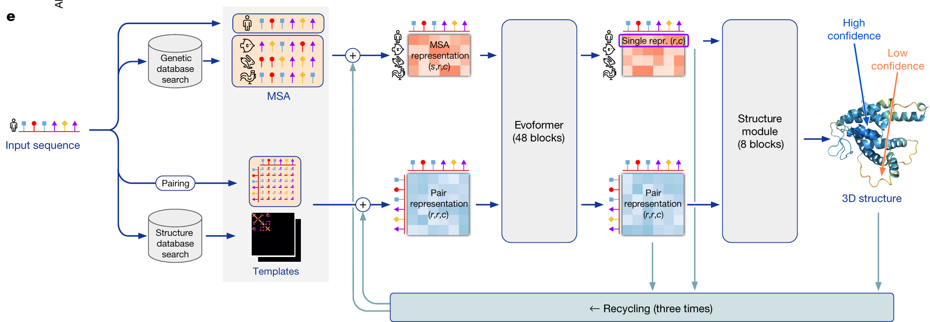
AlphaFold2 architecture
🔹 Feature Vector Construction
Raw input data (sequence, MSA, templates) is transformed into feature vectors which encode biochemical, evolutionary, and structural information.
🔹 Feature Embedding
Converts sequence, MSA, and template data into high-dimensional feature vectors.
Includes per-residue and pairwise representations.
🔹 Evoformer Module
Processes MSA and pair representations using attention and geometric reasoning.
Captures how residues interact and move relative to each other.
🔹 Structure Module
Predicts 3D atomic coordinates from processed features.
Uses invariant point attention to maintain spatial consistency.
Notes:
Takes input sequence, genetic sequence database to make MSA
Takes pdb sequences to find structures
High dimensional vectors for every MSA position, large structural object . No of seq, no of resides * 128
Takes meaningful representations from these MSA and structural module block. Uses residue to find how it come move about from one another. Keep them close in 3D space.
Merge it back into initial representations, recycle 3 times.
They train five different models; last three don’t use template information
All give diff versions of the 3D structure
Makes feature vectors out of raw data

Slide 6
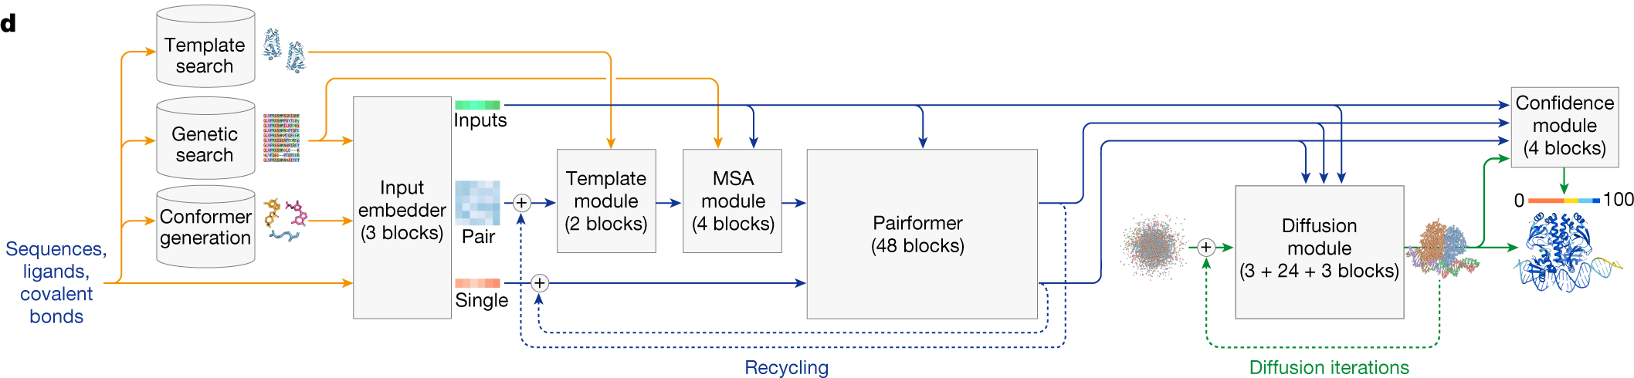
AlphaFold3 architecture
🔹 Reduced emphasis on MSA
Uses less compute power, only using the pair representation.
🔹 Feature Embedding
AlphaFold 3 predicts the precise positions of individual atoms, unlike AlphaFold 2, which focused on amino acid residues and side chains. This atomic-level modelling allows AlphaFold 3 to handle a wider variety of molecules.
🔹 Pairformer Module
The Pairformer module includes a smaller and simpler MSA embedding block.
This allows AlphaFold 3 to handle non-protein molecules (like ligands, RNA, ions) that don’t have MSA data.
🔹 Diffusion Module
Trained to receive “noised” atomic coordinates and predict the correct coordinates. The conditioning information is the sequence information for the target molecule or complex.
Notes:
Overall structure reflects AlphaFold2’s structure, where it involves pairwise representation of complex followed by structure module.
MSA processing is de-emphasised – uses less compute power, only using the pair representation. Abramson, J., Adler, J., Dunger, J. et al. Accurate structure prediction of biomolecular interactions with AlphaFold 3. Nature 630, 493–500 (2024). https://doi.org/10.1038/s41586-024-07487-w
Structure module replaced by diffusion module in AlphaFold3
Samples random noise, and iteratively denoises
Diffusion is a standard technique in machine learning. First, a high-information dataset is distorted by varying levels of random noise; subsequently, the neural network learns to restore it to the original data. The system uses a conditioning description for each example that should be restored. For example, when generating images, a typical conditioning might be a text description of the final image. During training, the network learns to generate plausible data to fit any given conditioning by incrementally stepping from pure noise to the final output.

Slide 7
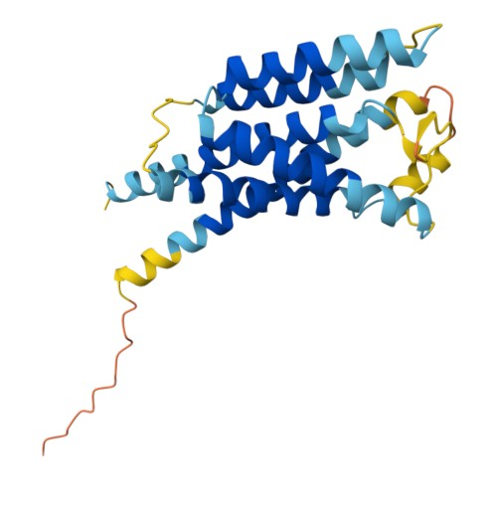
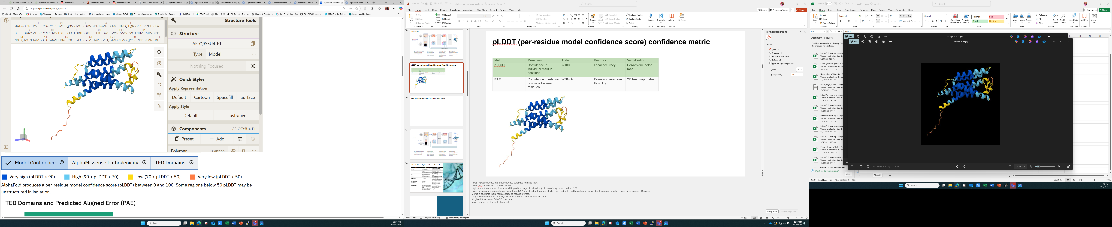
pLDDT (per-residue model confidence score) confidence metric
Metric | Measures | Scale | Best For | Visualisation
pLDDT | Confidence in individual residue positions | 0–100 | Local accuracy | Per-residue color map
PAE | Confidence in relative positions between residues | 0–30+ Å | Domain interactions, flexibility | 2D heatmap matrix
Insulin-induced gene 2 protein (Homo sapiens)
Single amino acid confidence measure, pLDDT (local accuracy metric)
pLDDT can help to:
Validate predictions: Know which regions to trust.
Guide experiments: Focus on high-confidence regions for mutagenesis or drug design.
Interpret flexibility: Low pLDDT may indicate intrinsically disordered regions.
Notes:
Takes input sequence, genetic sequence database to make MSA
Takes pdb sequences to find structures
High dimensional vectors for every MSA position, large structural object . No of seq, no of resides * 128
Takes meaningful representations from these MSA and structural module block. Uses residue to find how it come move about from one another. Keep them close in 3D space.
Merge it back into initial representations, recycle 3 times.
They train five different models; last three don’t use template information
All give diff versions of the 3D structure
Makes feature vectors out of raw data

Slide 8
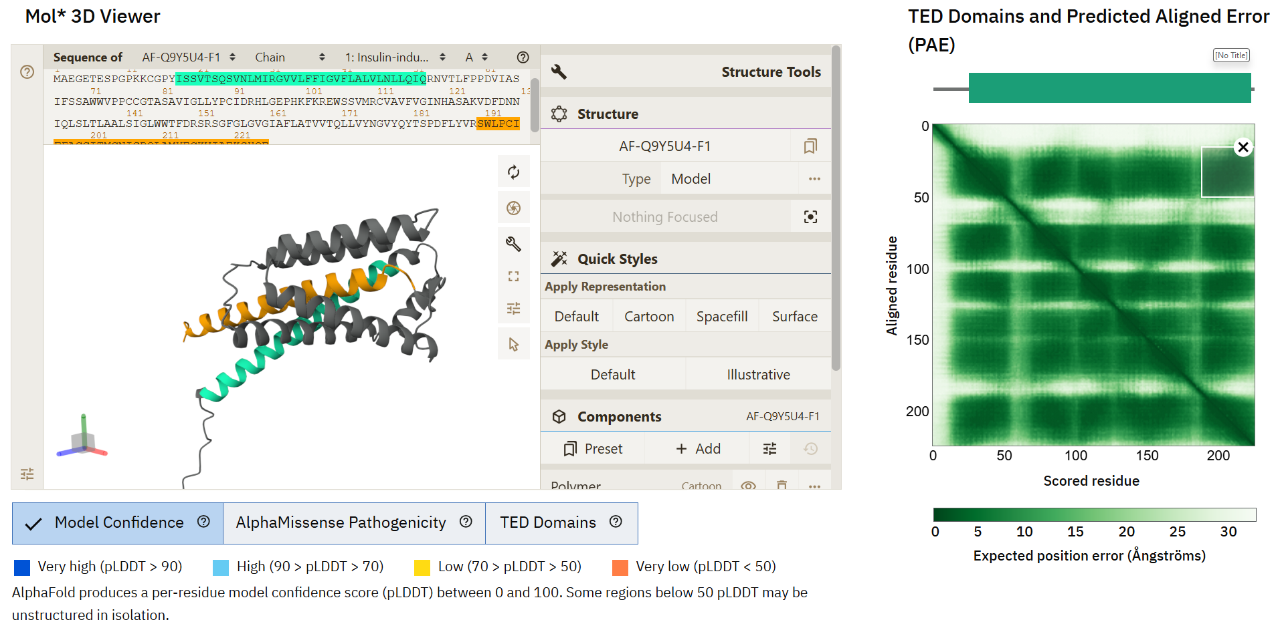
PAE (Predicted Aligned Error) confidence metric

Slide 9
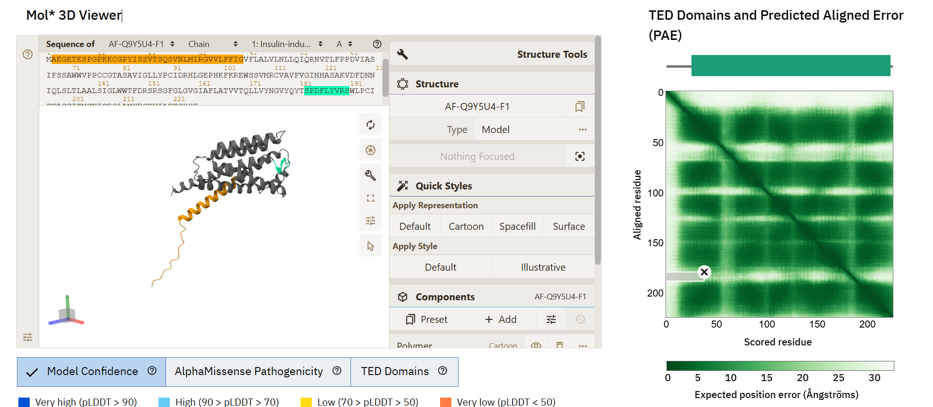
PAE (Predicted Aligned Error) confidence metric

Slide 10
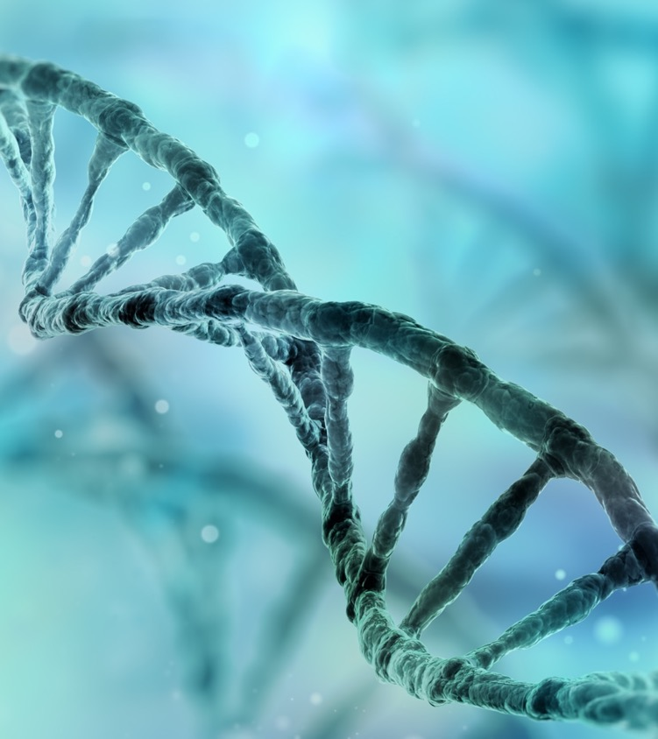
AlphaFold2 vs AlphaFold3 – what’s new?

Slide 11
Additional metrics from AlphaFold 3
pTM (Predicted Template Modelling Score)
Range: 0.0 to 1.0
Purpose: Measures overall global structural accuracy
Interpretation: Values higher than 0.8 represent confident high-quality predictions, while values below 0.6 suggest a failed prediction
Limitation: The TM score is very strict for small structures or short chains, so pTM can be less informative for smaller complexes
ipTM (Interface Predicted Template Modeling Score)
Range: 0.0 to 1.0
Purpose: Evaluates the accuracy of the predicted interface in a protein-protein complex
Critical Thresholds:
> 0.8: Indicates highly confident predictions/confidently predicted interactions
0.6-0.8: Grey zone where predictions could be correct or wrong
< 0.6: Suggest likely a failed prediction
Practical Cutoff: An ipTM score threshold of approximately 0.75 corresponds to a possible model confidence cutoff

Slide 12
Additional metrics from AlphaFold 3
Disorder (0.5 × disorder)
Refers to intrinsic disorder in protein regions—segments that lack a fixed or ordered 3D structure.
In AlphaFold3, this term likely reflects confidence in flexible or unstructured regions.
A higher disorder score may indicate biologically relevant flexibility and contributes positively to the ranking score.
Clash (-100 × has_clash)
Represents steric clashes—unrealistic overlaps between atoms in the predicted structure.
has_clash is likely a binary variable (1 if clash is present, 0 if not).
Clashes are penalized heavily (−100), as they indicate poor structural quality or physical implausibility.
AlphaFold3 Ranking Score Formula:
ranking_score = 0.8 × iPTM + 0.2 × pTM + 0.5 × disorder − 100 × has_clash

Slide 13

AlphaFold3 benchmarking
(Dürr and Rothlisberger, 2024)
“AF3 provides realistic predictions for metal ions”
AlphaFold3 vs RoseTTAfold-AllAtom
AlphaFold 3 placed small molecules (ATP) into their natural binding sites, even when mutations should have blocked the interaction.
(Wu et al., 2024)
AlphaFold 3 “showed strong performance”
AlphaFold3 vs AlphaFold2 (TCRmodel2)
Specialised implementation of AlphaFold2, TCRmodel2 performed better
Can AlphaFold3 “learn” the physics of protein-ligand interactions?
(Zheng et al., 2025)
AF3 significantly outperformed traditional docking methods, particularly in the accuracy of side-chain orientations.
Protein-ligand interactions
(Masters et al., 2024)
Adapted from EMBL-EBI: https://www.ebi.ac.uk/training/online/courses/alphafold/
Notes:
Wu et al - It is necessary to sample many seeds to obtain AlphaFold 3’s best predictions for immune system proteins
A third preprint explored whether deep learning systems can learn the physics of protein-ligand interactions. They found “a significant divergence from expected physical behaviours”. In particular, AlphaFold 3 placed small molecules like ATP and heme into their natural binding sites, even if the protein residues that formed the binding site had been mutated to prevent any such interaction. The authors interpreted this to mean that AlphaFold 3 predicts the binding positions of small molecules “not based on molecular interactions”, but using patterns observed in regions distant from the binding site, or in the overall fold of the proteins (Masters et al., 2024).

Slide 14
AlphaFold3 benchmarking
Study | What They Did | Pro | Con
Dürr & Rothlisberger (2024) | Compared AF3 to RoseTTAfold-AllAtom for metal-protein interactions | Realistic metal ion predictions | Limited scope—focused only on metal ions
Wu et al. (2024) | Assessed TCR binding to NRAS neoantigens | Strong performance in TCR modeling | Under-sampled AF3, limiting its potential
Masters et al. (2024) | Tested AF3 on mutated binding sites | Reveals pattern-based binding prediction | Ignores physical constraints, risking unrealistic outputs
Lu et al. (2024) | Benchmarked AF3 on SKEMPI binding energy dataset | Learns features useful for binding energy estimation | Binding energy prediction still needs refinement
Bernard et al. (2025) | Evaluated AF3 on RNA structure prediction | Accurate torsion angles, good ribosome modeling | Struggles with long RNAs and non-Watson-Crick interactions
Zheng et al. (2025) | Drug discovery benchmark for static protein-ligand binding | Outperforms docking methods in static cases | Bias toward active GPCR conformations
Shamir & London (2025) | COValid benchmark for covalent ligand prediction | Near-perfect classification, generalization beyond training | Limited to covalent interactions; broader applicability unclear
Xu et al. (2025) | FoldBench all-atom benchmark across diverse tasks | Best overall performance, strong generalization | >50% failure rate in antibody-antigen prediction; ligand similarity affects accuracy

Slide 15
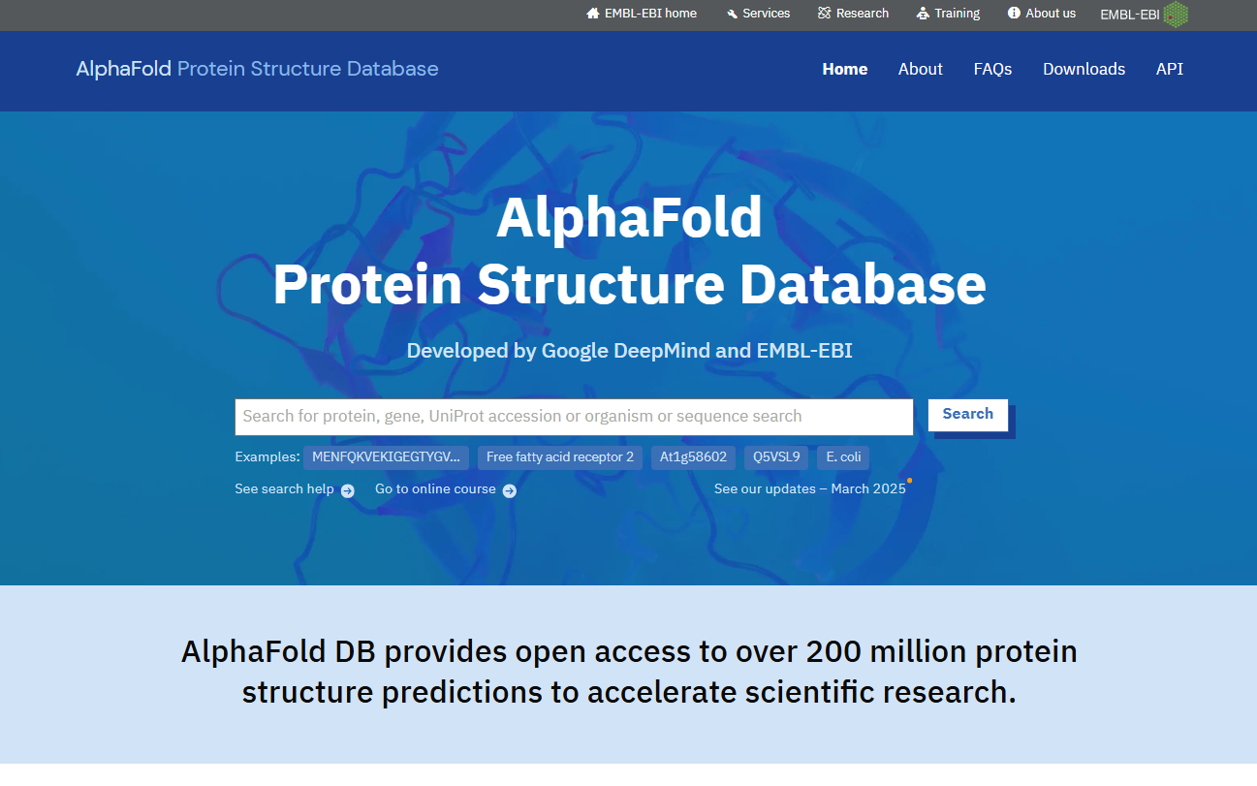
Interactive Activity #1: AlphaFold Database
Protein Structure Predictions: The AlphaFold Database provides highly accurate predictions of protein 3D structures using DeepMind’s AlphaFold AI model
Extensive Coverage: It includes millions of protein structures from a wide range of organisms, including humans, plants, bacteria, and viruses, supporting research in medicine, agriculture, and biotechnology.
Open Access Resource: The database is freely available to researchers worldwide, hosted by the European Bioinformatics Institute (EMBL-EBI), promoting open science and accelerating discoveries in life sciences.

Slide 16
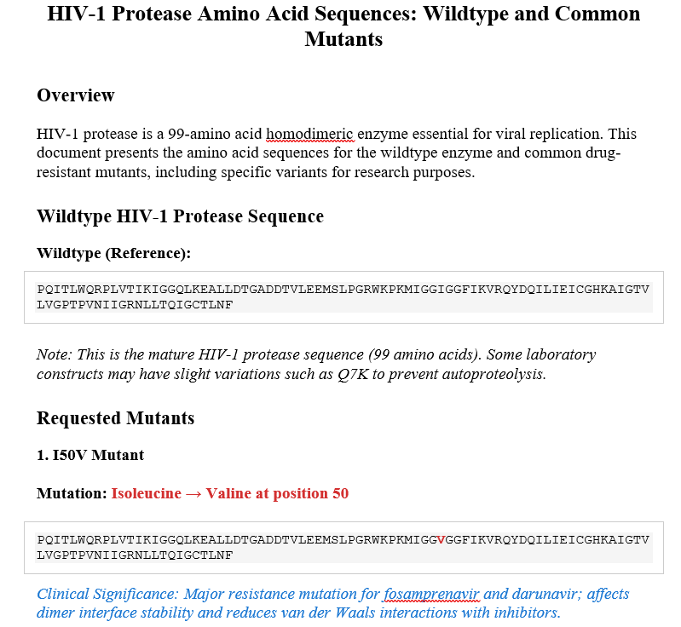
Interactive Activity #1: AlphaFold Database

Slide 17
Interactive Activity #1: AlphaFold Database
Task: Select a mutant of your choice and explore it in the AlphaFold Protein Structure Database
https://alphafold.com/

Slide 18
Summary + Wrap-up
Key objectives:
1. Understand architectural differences between AF2 and AF3,
2. Understand AF3 metrics; pLDDT, PAE, iPTM,
3. Navigate the AlphaFold protein database and UniProt,
4. Use the AlphaFold3 server to visualise your protein structures.

Slide 19
Tomorrow?
Case study – HIV1-protease

Slide 20
Workshop agenda, Day 2

Slide 21
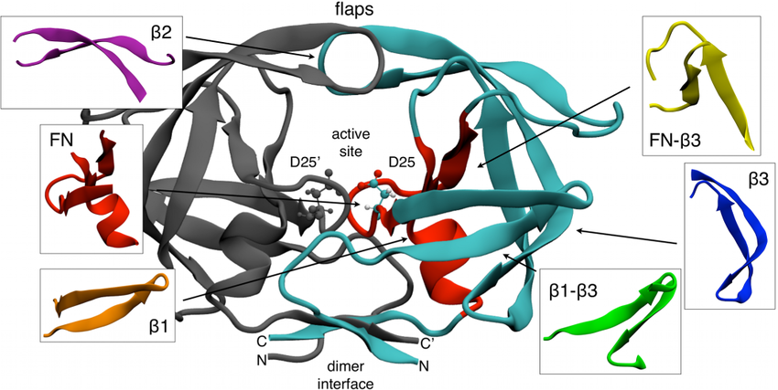
HIV-1 protease – structure and function
Structural Overview
HIV-1 protease (PR) is a homodimeric aspartyl protease, with each monomer comprising 99 amino acids. The active site is formed at the dimer interface, with each monomer contributing one catalytic aspartate (Asp25 and Asp25′), essential for enzymatic activity
The enzyme cleaves the Gag and Gag-Pol polyproteins at specific sites, enabling the maturation of infectious virions
Functional Dynamics
The protease flaps—flexible β-hairpin loops—play a critical role in substrate and inhibitor binding. These flaps open to allow substrate entry and close to stabilize the bound ligand. Structural studies have shown that flap dynamics are tightly linked to inhibitor efficacy and resistance

Slide 22
HIV-1 protease – structure and function
Drug Targeting and Resistance
Due to its essential role in viral replication, HIV-1 PR has been a major target in antiretroviral therapy. However, rapid viral mutation and structural plasticity of the protease allow it to tolerate extensive mutations, leading to drug resistance. Resistance mutations can occur both at the active site and at distal sites that affect flap dynamics or dimer stability

Slide 23
Darunavir – mechanism of action
Darunavir: Mechanism of Action and Resistance
Binding Mechanism
Darunavir (DRV) is a second-generation protease inhibitor with a high genetic barrier to resistance. It binds tightly to the active site of the HIV-1 protease dimer, forming extensive hydrogen bonds and van der Waals contacts, particularly with the backbone atoms of the protease, which are less prone to mutation
Molecular dynamics simulations show that DRV binds between the flap and active site of the monomer, inducing conformational changes that may prevent dimer formation
Resistance Profile
Darunavir is effective against many PI-resistant HIV strains. However, resistance can still emerge, particularly through mutations in the Gag cleavage sites or compensatory mutations in the protease that reduce inhibitor binding while maintaining enzymatic function.

Slide 24
AlphaFold3 – mutant comparisons
wt-darunavir complex
I50V mutant-darunavir complex
MDR mutant-darunavir complex
{
"chain_iptm": [
0.95,
0.95,
0.94
],
"chain_pair_iptm": [
[
0.93,
0.95,
0.94
],
[
0.95,
0.93,
0.94
],
[
0.94,
0.94,
0.77
]
],
"chain_pair_pae_min": [
[
0.76,
0.77,
0.8
],
[
0.77,
0.76,
0.79
],
[
0.96,
0.94,
0.76
]
],
"chain_ptm": [
0.93,
0.93,
0.77
],
"fraction_disordered": 0.07,
"has_clash": 0.0,
"iptm": 0.96,
"ptm": 0.96,
"ranking_score": 1.0
{
"chain_iptm": [
0.95,
0.95,
0.94
],
"chain_pair_iptm": [
[
0.93,
0.95,
0.94
],
[
0.95,
0.93,
0.94
],
[
0.94,
0.94,
0.77
]
],
"chain_pair_pae_min": [
[
0.76,
0.77,
0.8
],
[
0.77,
0.76,
0.79
],
[
0.99,
0.94,
0.76
]
],
"chain_ptm": [
0.93,
0.93,
0.77
],
"fraction_disordered": 0.06,
"has_clash": 0.0,
"iptm": 0.96,
"ptm": 0.96,
"ranking_score": 0.99
{
"chain_iptm": [
0.94,
0.94,
0.93
],
"chain_pair_iptm": [
[
0.92,
0.94,
0.93
],
[
0.94,
0.92,
0.94
],
[
0.93,
0.94,
0.75
]
],
"chain_pair_pae_min": [
[
0.76,
0.78,
0.83
],
[
0.78,
0.76,
0.81
],
[
1.04,
0.99,
0.76
]
],
"chain_ptm": [
0.92,
0.92,
0.75
],
"fraction_disordered": 0.07,
"has_clash": 0.0,
"iptm": 0.95,
"ptm": 0.95,
"ranking_score": 0.99
Minimal changes to iPTM scores

Slide 25
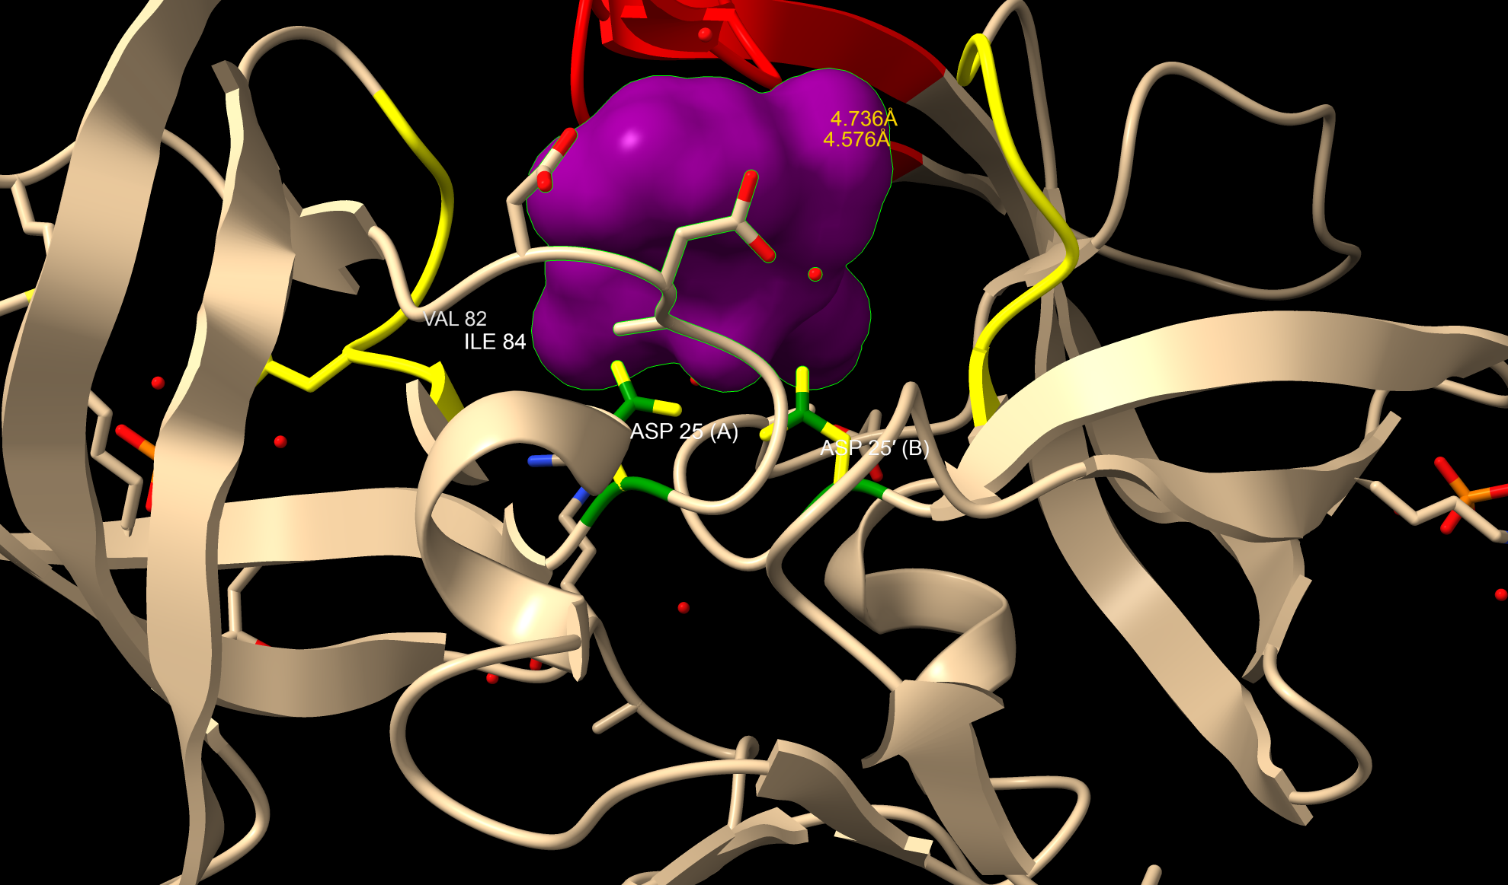
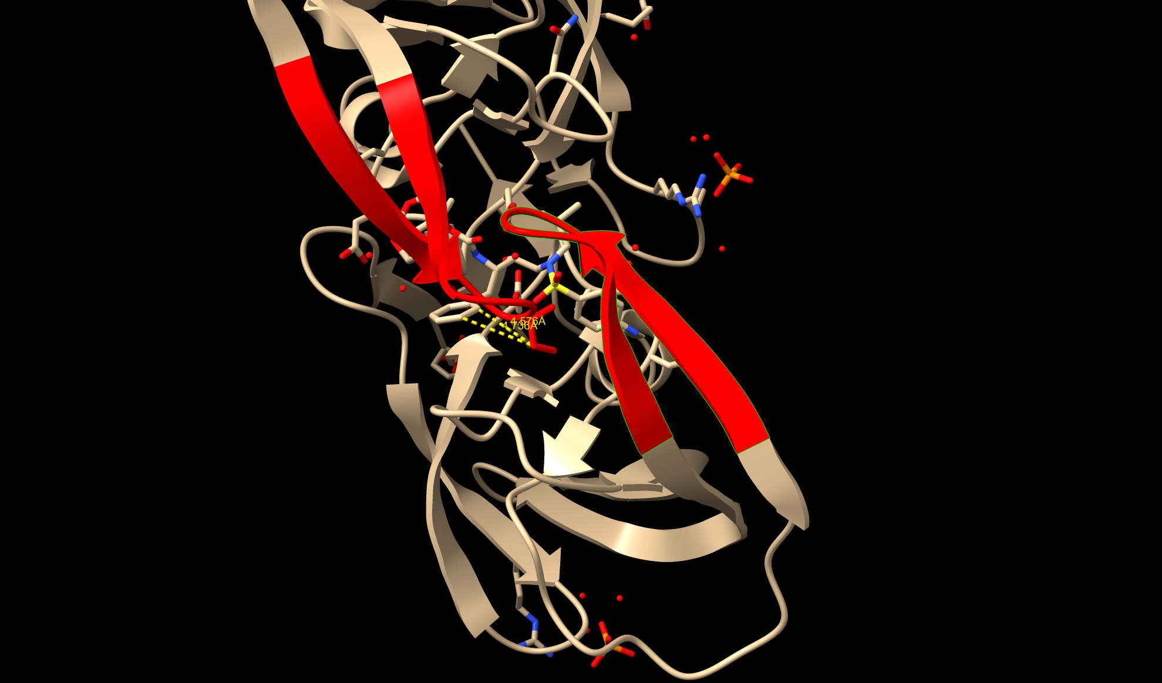
Key regions and ligand atom contact points
Ligand atom 24 - 28: active site
Ligand atom 46 - 54: flap regions
Active Site (residues 23–30 in each monomer)
.
Key residues: Asp25, Thr26, Gly27, Ala28, Asp29, Asp30
Catalytic dyad: Asp25 and Asp25′ — essential for peptide bond hydrolysis
Function: enzymatic core, cleaves viral polyproteins.
Flap Region (residues 43–58 in each monomer)
Glycine-rich β-hairpin structures that cover the active site and regulate substrate/inhibitor access.
Key residues: Gly46, Ile47, Gly48, Ile50, Gly51, Gly52, Ile54, Val56 Notable mutation sites: I50V, G48V, I54V — commonly associated with drug resistance
Function: Contribute to flap flexibility and dynamics, crucial for opening/closing over the active site.

Slide 26
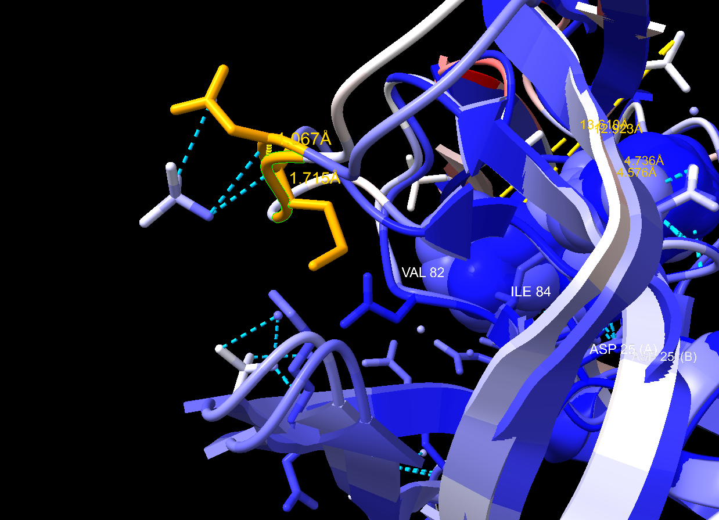
Key regions and ligand atom contact points
Hinge Region (residues 35–42 in each monomer)
The hinge connects the flaps to the protease core and influences flap movement.
Key residues: Gly35, Gly36, Gly40, Lys41, Leu42
Function: Acts as a pivot point for flap dynamics; mutations here can affect flap opening and drug binding

Slide 27
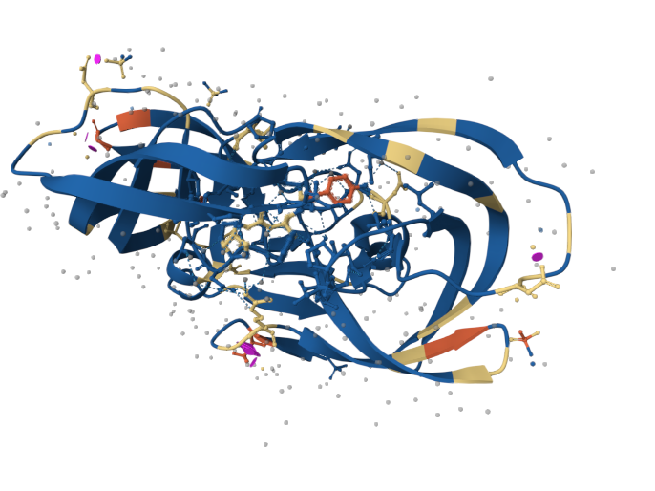
Interactive Activity #2: Decoding HIV1 protease mutants
Activity 2.1: Running wild-type, I50V, I84V and multidrug-resistant mutants predictions on AlphaFold3 server
Activity 2.2: Comparison of ligand-binding between three models

Slide 28
Results summary – I50V mutant analysis (PDB: 6dh6)
Flap Tip Mutation and Shielding
Mutation: Isoleucine → Valine at position 50 (flap tip)
Shorter side chain reduces hydrophobic surface area.
Increased distances to ligand atoms C36 and C37 (~+3.3 Å).
Partial shielding retained via close contact with S8.
Mechanistic Insight:
Flap destabilization leads to moderate resistance.
Darunavir binding is weakened but not abolished.
Represents a subtle shift in flap-ligand interaction.
Residue | Atom | Ligand Atom | WT Distance (Å) | I50V Distance (Å) | Δ Distance (Å)
VAL 50 | CG1 | C36 | 4.736 | 8.105 | 3.369
VAL 50 | CG1 | C37 | 4.576 | 7.798 | 3.222
VAL 50 | CG1 | C35 | 5.969 | 7.252 | 1.283
VAL 50 | CG1 | C33 | 6.778 | 5.419 | -1.359
VAL 50 | CG1 | C34 | 6.883 | 5.852 | -1.031
VAL 50 | CG1 | C38 | 5.73 | 6.512 | 0.782
VAL 50 | CG1 | S8 | 4.713 | 3.995 | -0.718
VAL 50 | CG1 | N11 | 6.226 | 5.463 | -0.763

Slide 29
Results summary – I84V mutant analysis (PDB: 6dh0)
Pocket Mutation and Moderate Disruption
Mutation: Isoleucine → Valine at position 84 (S1/S1′ pocket)
All distances to ligand atoms increased (~+1.1 to +1.9 Å).
Loss of hydrophobic packing in the binding cleft.
Mechanistic Insight:
Ligand remains enclosed, but packing is looser.
Resistance is moderate, driven by reduced contact surface.
Highlights the role of pocket integrity in inhibitor efficacy.
Residue | Atom | Ligand Atom | WT Distance (Å) | I84V Distance (Å) | Δ Distance (Å)
VAL 84 | CG1 | C24 | 5.937 | 7.461 | 1.524
VAL 84 | CG1 | C25 | 5.215 | 7.088 | 1.873
VAL 84 | CG1 | C27 | 7.439 | 9.127 | 1.688
VAL 84 | CG1 | C29 | 8.512 | 9.652 | 1.14
VAL 84 | CG1 | O26 | 6.199 | 7.897 | 1.698
VAL 84 | CG1 | O28 | 8.18 | 9.593 | 1.413

Slide 30
Multi-drug resistant mutant analysis (PDB: 5t2z)
Multi-Mutant Collapse of Binding:
17 mutations including G48V, M46L, V82S, E35D, L90M
Flap residues (e.g., PHE 53) show +5–6 Å increases.
Pocket residues (e.g., ILE 84) show +5–7 Å increases.
Flaps adopt open, curled conformation even when bound.
Mechanistic Insight:
Synergistic mutations disrupt flap closure, ligand enclosure, and binding energetics.
Darunavir binding is ~10,000× weaker than wildtype.
PR S17 represents extreme resistance and dynamic collapse.
Residue | Atom | Ligand Atom | WT Distance (Å) | PR S17 Distance (Å) | Δ Distance (Å)
ILE 50 | CG1 | C36 | 4.736 | 8.064 | 3.328
ILE 50 | CG1 | C37 | 4.576 | 7.635 | 3.059
PHE 53 | CZ | C36 | 8.872 | 15.097 | 6.225
PHE 53 | CZ | C37 | 10.061 | 15.375 | 5.314
ILE 84 | CG1 | C24 | 5.937 | 11.279 | 5.342
ILE 84 | CG1 | C25 | 5.215 | 12.426 | 7.211
ILE 84 | CG1 | C27 | 7.439 | 12.326 | 4.887
ILE 84 | CG1 | C29 | 8.512 | 10.243 | 1.731
ILE 84 | CG1 | O26 | 6.199 | 12.646 | 6.447
ILE 84 | CG1 | O28 | 8.18 | 11.584 | 3.404

Slide 31
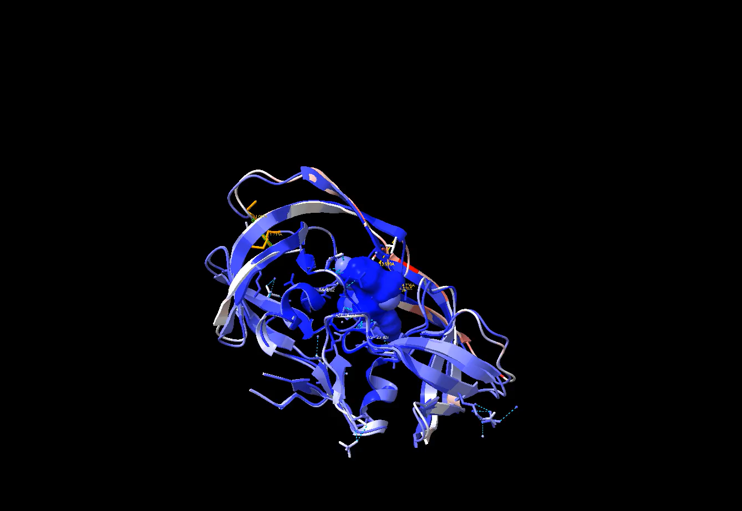
A closer look at the multi-mutant:
rmsd #3:45-55@CA to #1:45-55@CA RMSD between 22 atom pairs is 1.015 Å
RMSD using Cα atoms only for residues 45–55. It matched 22 atom pairs and the RMSD is 1.015 Å. Why 22 atom pairs? Because your protease is a homodimer: residues 45–55 appear in both chains, so you get 11 residues × 2 chains = 22 Cα pairs.
rmsd #3:24-28@CA to #1:24-28@CA RMSD between 10 atom pairs is 0.2
0.2 Å (residues 45-55) — The flap region shows minimal conformational differences.
rmsd #3:36-37@CA to #1:36-37@CA RMSD between 4 atom pairs is 3.9 For residues 36–37 the RMSD is 3.9 Å (4 pairs → 2 residues × 2 chains). That’s a substantial displacement — these residues differ most between the two structures.
matchmaker #3:24-28@CA to #1:24-28@CA This is ChimeraX’s confirmation that it performed a sequence/structure-based match (superposition) of the 24–28 Cα atoms between model #3 and model #1 (you used the match/matchmaker command).
Interpretation
1.015 Å (residues 45–55) — very small difference. The flap region (45–55) is essentially in the same place between the two models when measured by Cα positions (i.e., little backbone shift).
1.548 Å (24–28) — moderate backbone movement in that segment.
3.9 Å (36–37) — large local rearrangement at residues 36–37. This is where the conformational change is most pronounced and may be functionally relevant (check if these residues contact the ligand or contribute to the active site).

Slide 32
Mike Kuiper Presentation and Q&A

Slide 33
Summary + Wrap-up
AlphaFold3 enables modelling of varying complexes (protein-protein, RNA-protein, ligand-protein)
These studies can be used to explore dynamics of common mutations in infectious diseases

Slide 34
Tomorrow?
Molecular docking

Slide 35
Time | Topics
9.30-10.00 | Breakfast
10.00-10.30 | Protein structural comparison (RMSD, and TM scores)
10.30-11.00 | Torsonial angles and Ramachandran plots
11.00-11.15 | Short Break
11.15-12.00 | Docking walkthorough - theoritical, things to understand, assumptions, calculations etc
12:00-13:00 | Lunch break
1-1:30 | Ligands Lipinski rule of 5, Pocket prediction, Fppocket and PyKVfinder and interpretation, Docking preparation
1.30 - 2:30 | Autodock VINA based docking and interpretations, AlphaFold predicted interfaces
2.30 - 3.00 | Diffusion model-based docking, some molecular dynamics teasers
Workshop agenda, Day 1
Workshop agenda, Day 3
Workshop agenda, Day 1

Slide 36
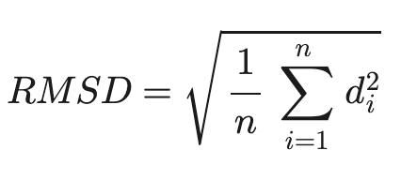
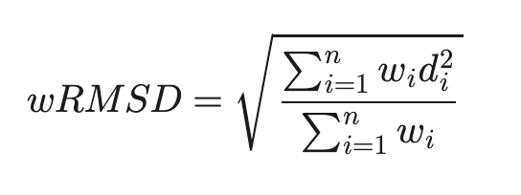
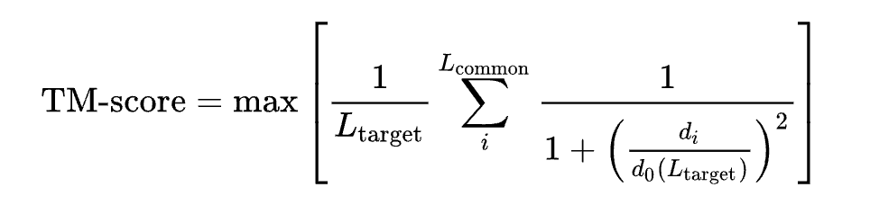
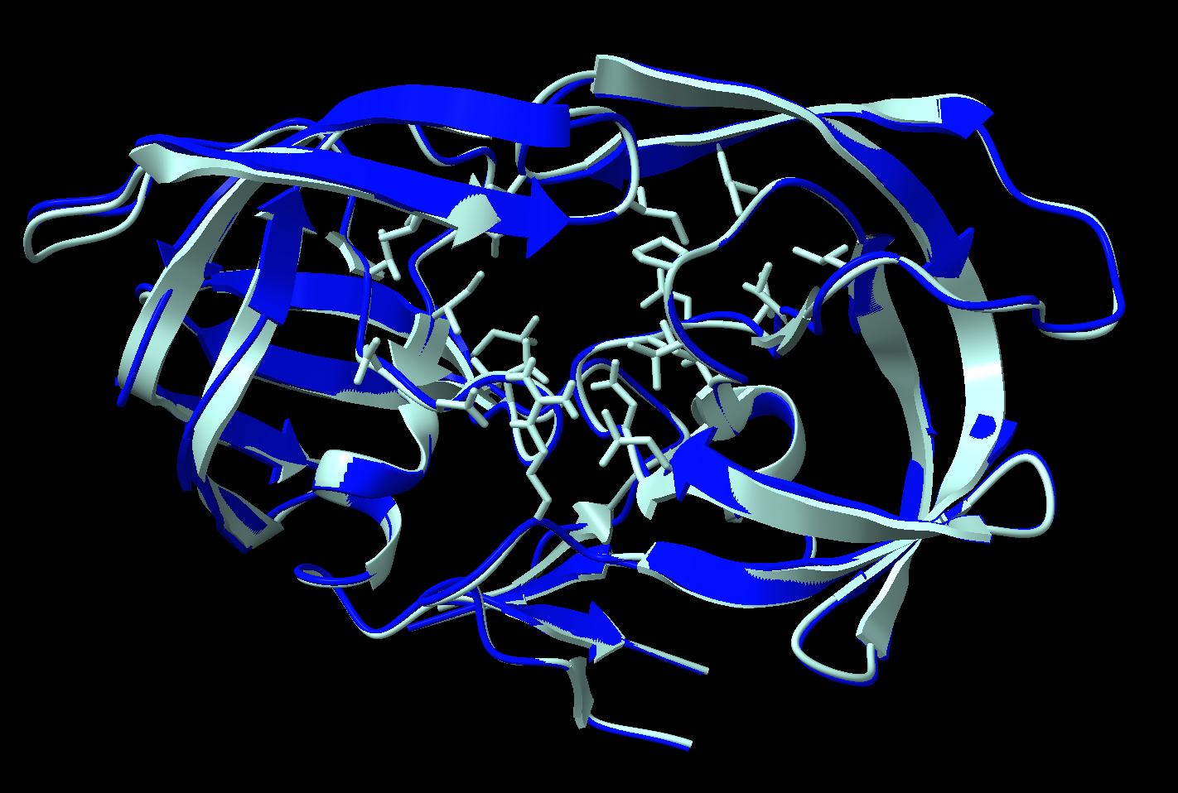
Assessing structural similarity between target and reference
Root-mean square deviation
Template modelling score (TM score)
RMSD | Remarks
<2 Å | High similarity
2-4 Å | Somewhat similar
>4 Å | Low similarity
→ Empirical length-based scaling factor
Max over all structural alignments, d_{i} is the distance between the i^{th} pair of aligned residues (usually carbon-alpha atoms) after alignment.
The main disadvantage of RMSD method is that it is dominated by the amplitudes of errors and protein length
X-ray crystal structure of HIV-1 protease (cyan) with its Alphafold predicted model(dark blue) (RMSD ~0.3Å)
Online Tool: https://zhanggroup.org/TM-score/
https://pmc.ncbi.nlm.nih.gov/articles/PMC4321859/
https://charmm-gui.org/?doc=lecture&module=scientific&lesson=11

Slide 37
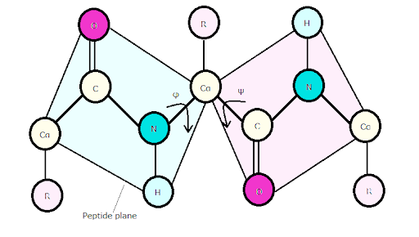
Torsional angles in peptides - refresher
C⍺ – N = ɸ, C- C⍺ = Ψ
https://proteopedia.org/wiki/index.php/Phi_and_Psi_Angles
http://cib.cf.ocha.ac.jp/bitool/DIHED2/

Slide 38
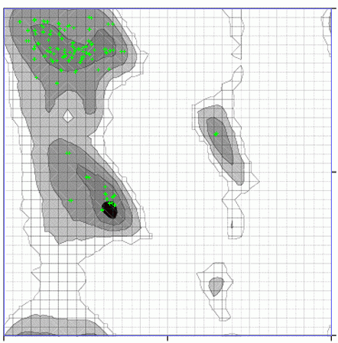
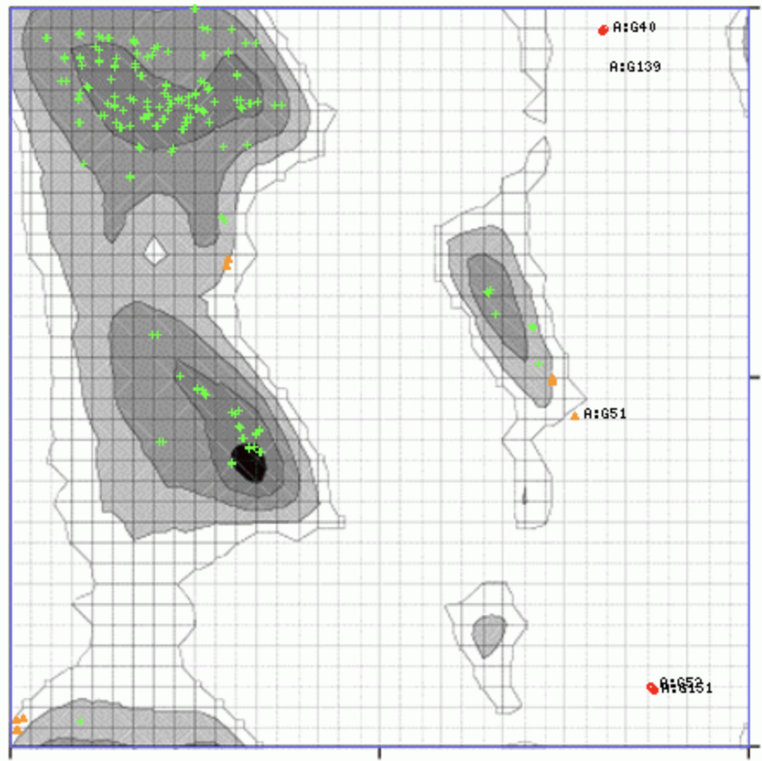
Ramachandran plot
HIV-1-Protease-AlphaFold
Ψ
ɸ
Beware: Glycine’s and Proline’s are a bit “weird”
https://bu.wenglab.org/rama/

Slide 39
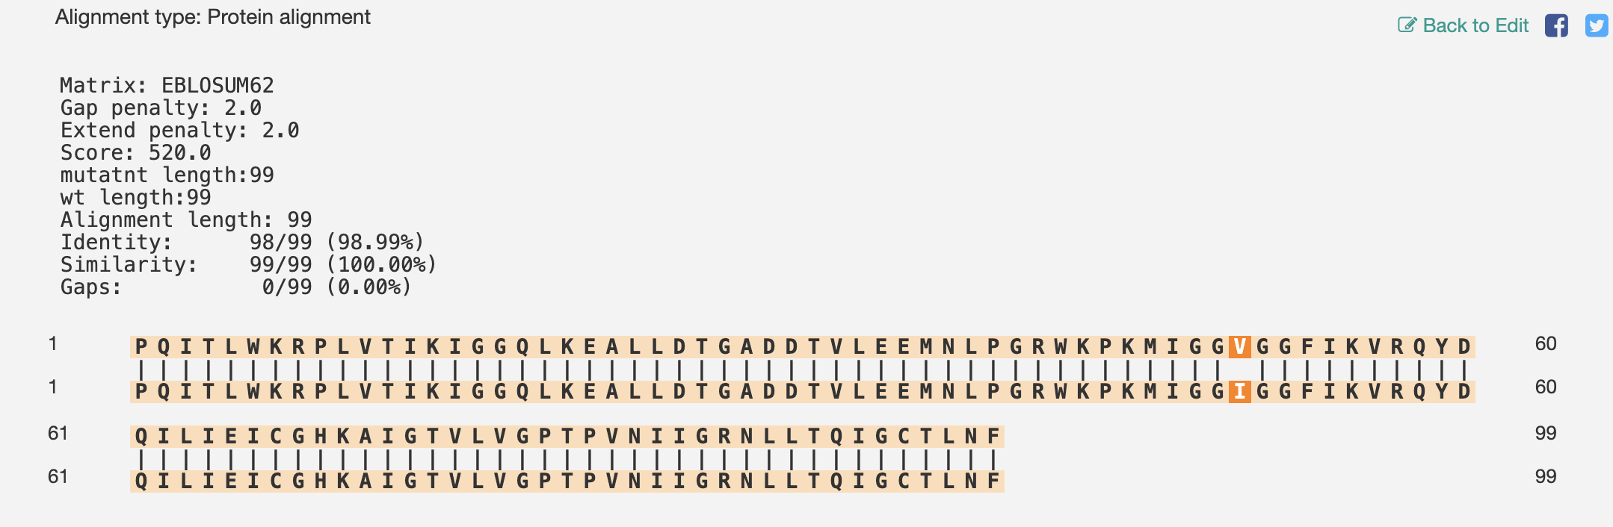
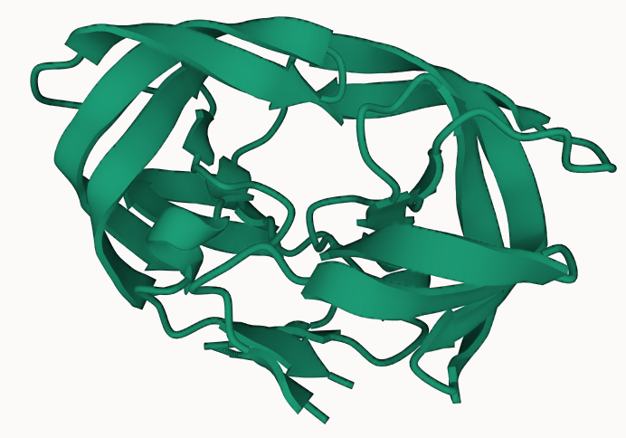
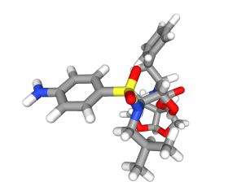
Know your proteins – HIV-1 Protease
https://en.vectorbuilder.com/tool/sequence-alignment.html
PDB structures: 6OPS (WT) VS 6DH6 (Darunavir mutant I50V)
Darunavir, protease inhibitor

Slide 40
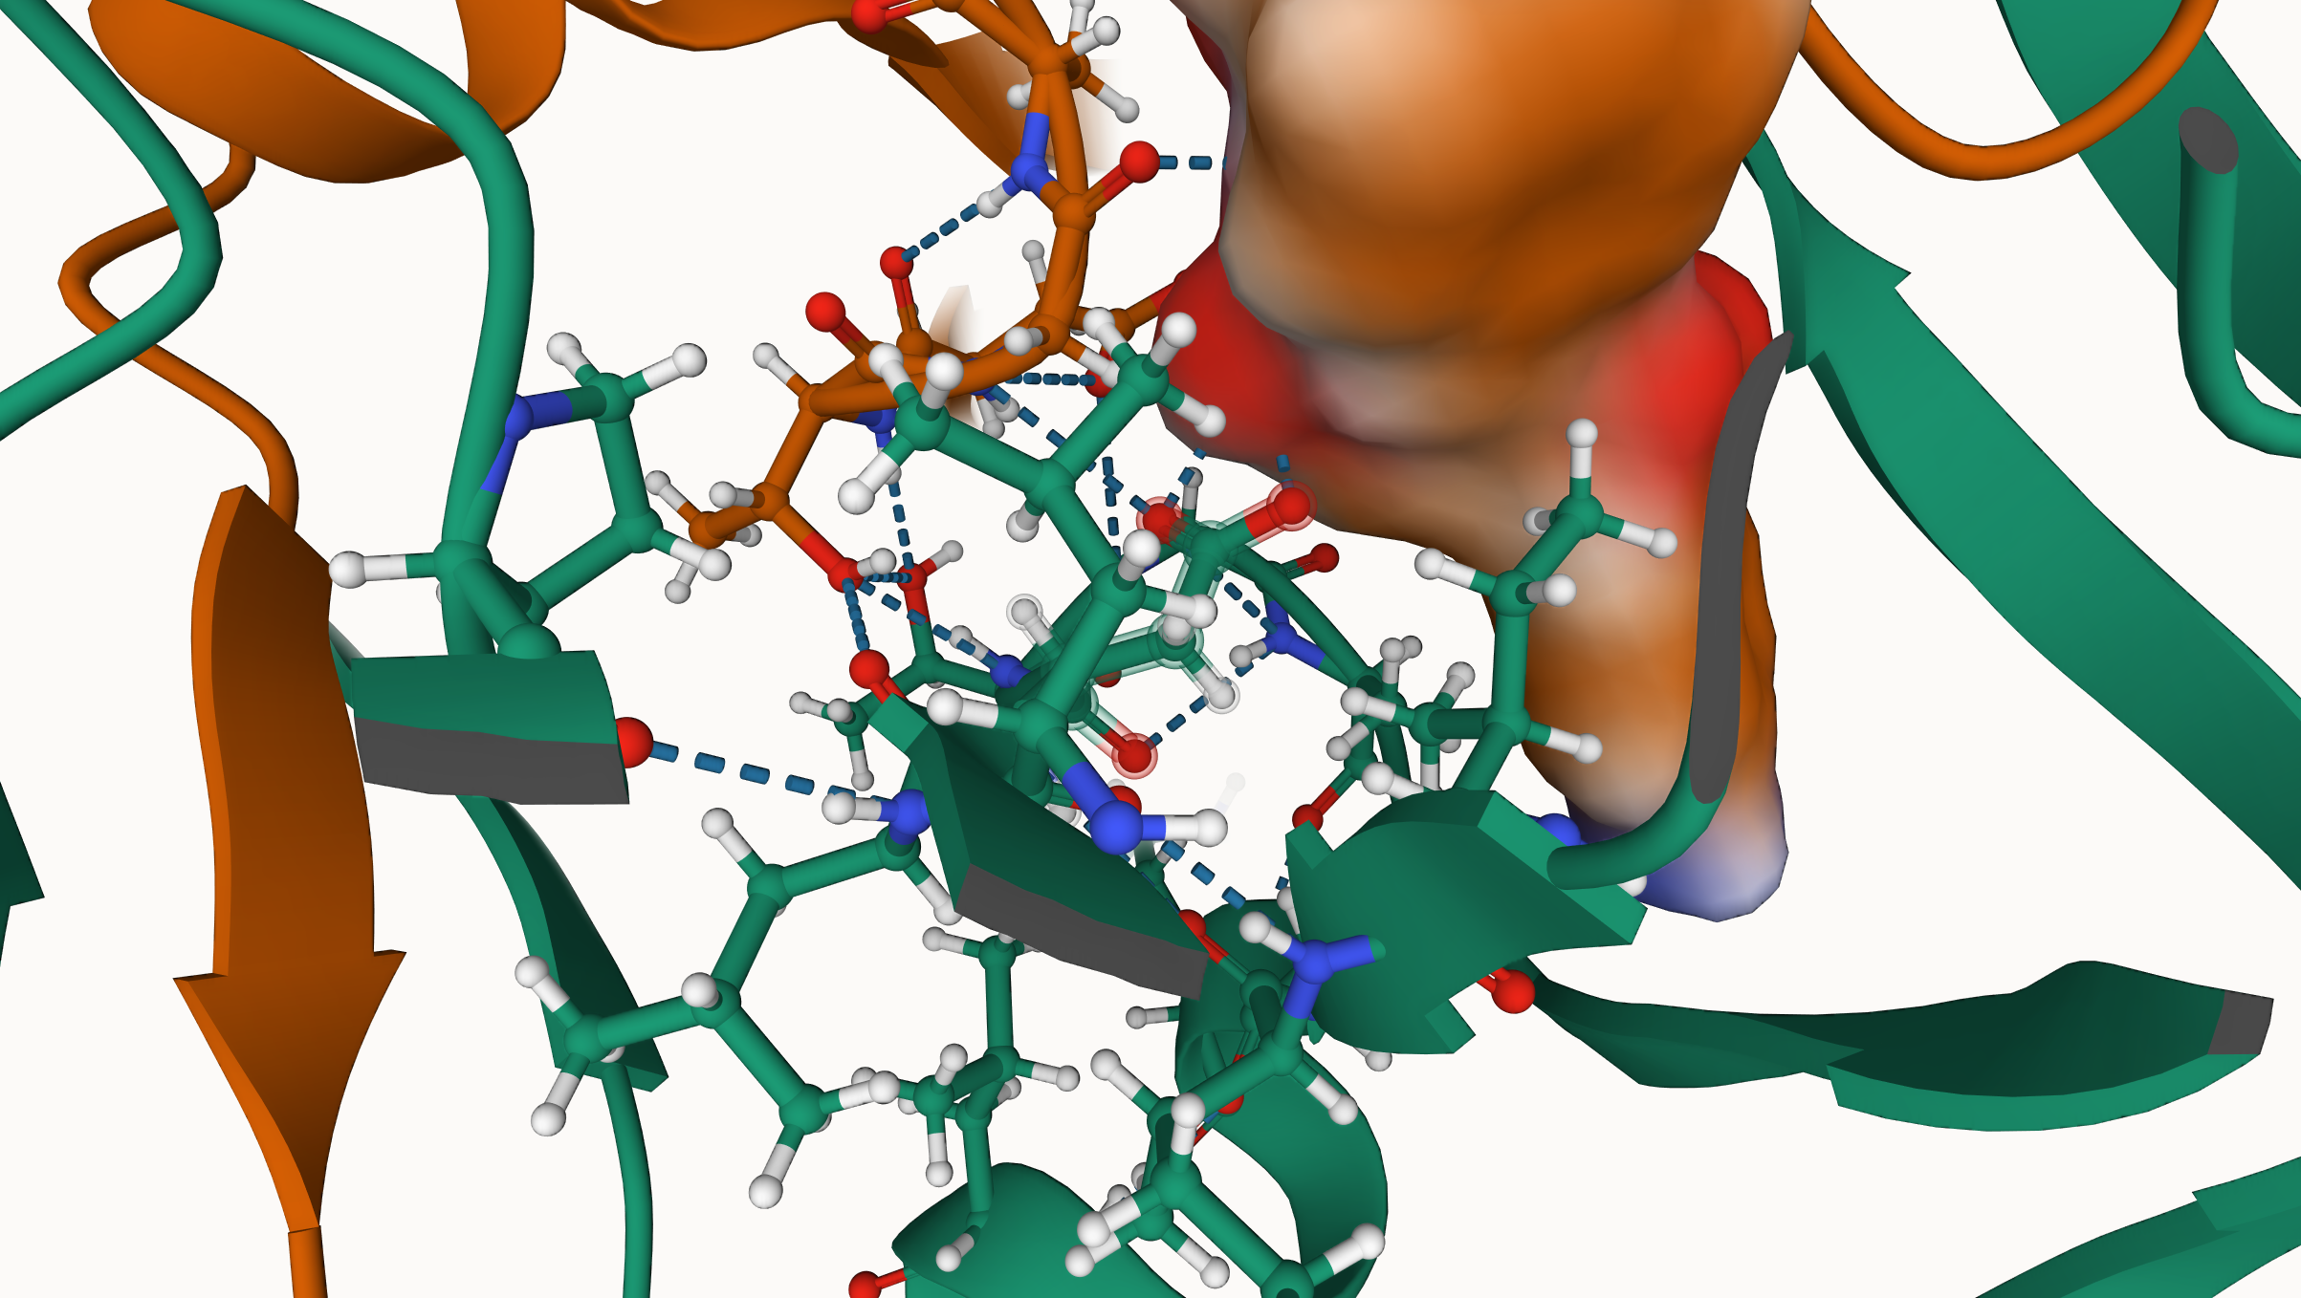
HIV-1 Protease – Mechanism of action
The catalytic site of HIV-1 protease is formed by a highly conserved triad of residues - Asp25, Thr26, and Gly27- from each monomer of the homodimeric enzyme
Darunavir (1) binds tightly to the active site, and (2) also inhibits the enzyme’s ability to dimerize
Hydrogen bonds with Asp25
Darunavir with mol surface representation

Slide 41
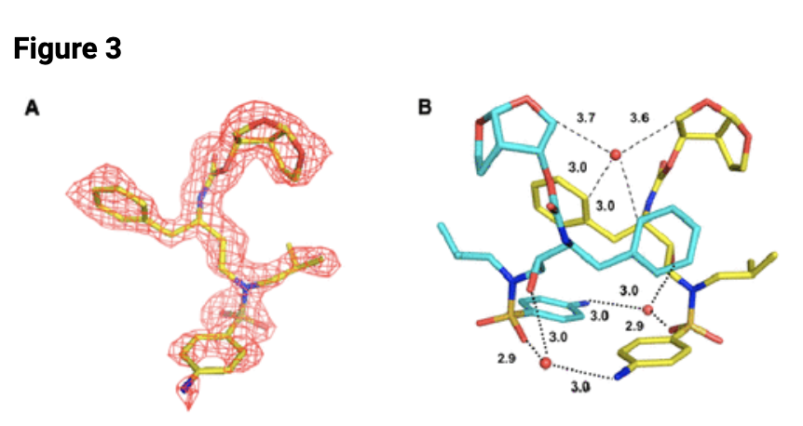
HIV-1 Protease – Water molecules can also mediate H-bonds
The catalytic site of HIV-1 protease is formed by a highly conserved triad of residues - Asp25, Thr26, and Gly27- from each monomer of the homodimeric enzyme
Darunavir (1) binds tightly to the active site, and (2) also inhibits the enzyme’s ability to dimerize
https://pubs.acs.org/doi/10.1021/cb4008875

Slide 42
Docking Process

Slide 43
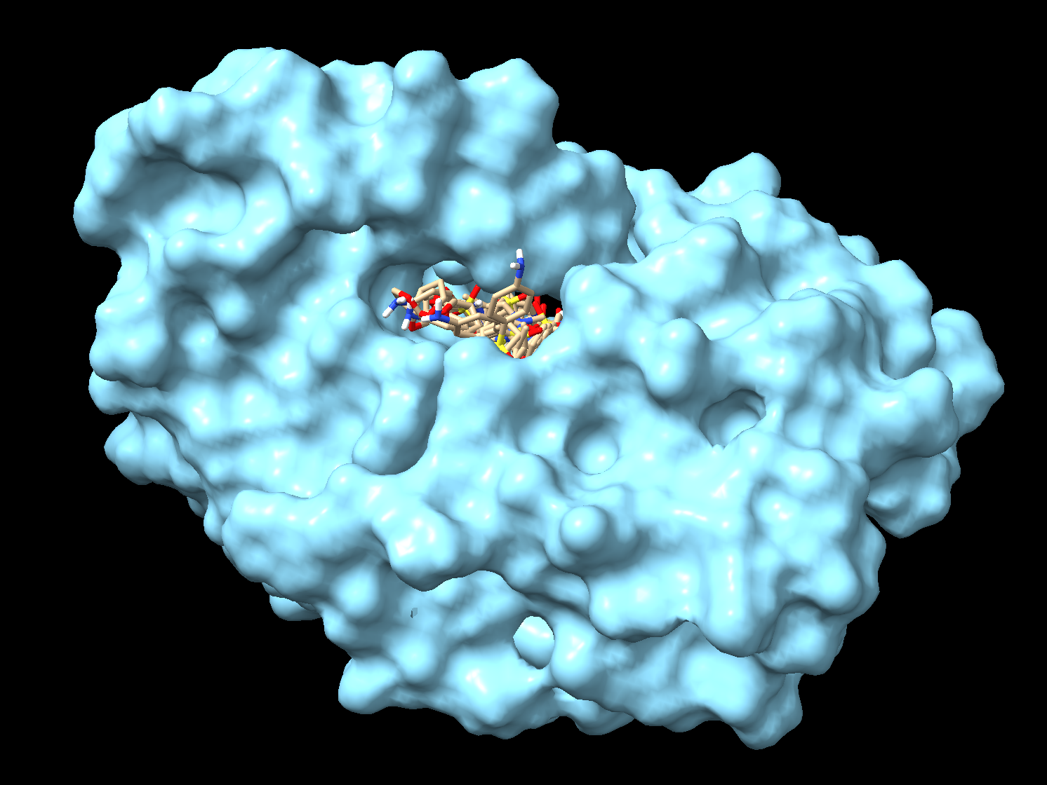
Molecular Docking
“The goal of ligand-protein docking is to predict the predominant binding mode(s) of a ligand with a protein of known three-dimensional structure”
https://pubmed.ncbi.nlm.nih.gov/18446297
”Poses” of Darunavir in the HIV-1 protease active site

Slide 44
Energy minimisation
Energy
Local minimum
Local minimum
Global minimum
Conformation

Slide 45
Energy minimisation
Energy
Local minimum
Local minimum
L-BFGS minimisation
Global minimum
RosettaRelax
Conformation

Slide 46
Energy minimisation
# Create the system
system = forcefield.createSystem(pdb.topology, nonbondedMethod=app.PME,
nonbondedCutoff=1.0*unit.nanometers, constraints=app.HBonds)
integrator = om.LangevinIntegrator(300*unit.kelvin, 1.0/unit.picoseconds,
2.0*unit.femtoseconds)
# Create Context
simulation = app.Simulation(pdb.topology, system, integrator)
simulation.context.setPositions(pdb.positions)
# Perform energy minimization
simulation.minimizeEnergy(maxIterations=500,
tolerance=10.0*unit.kilojoule_per_mole/unit.nanometer)

Slide 47
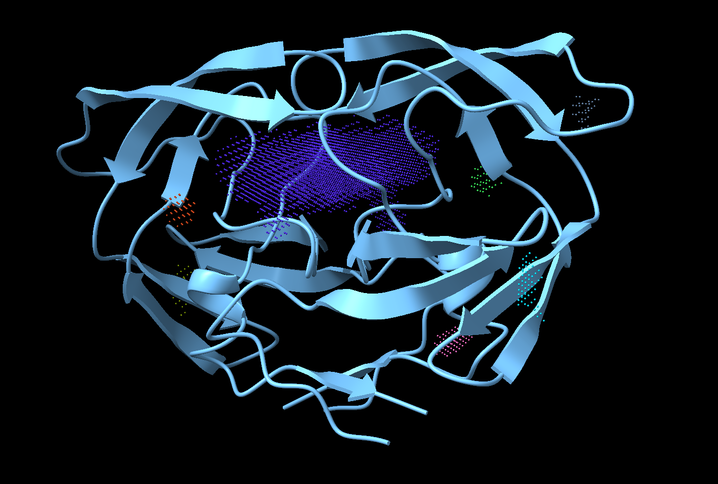
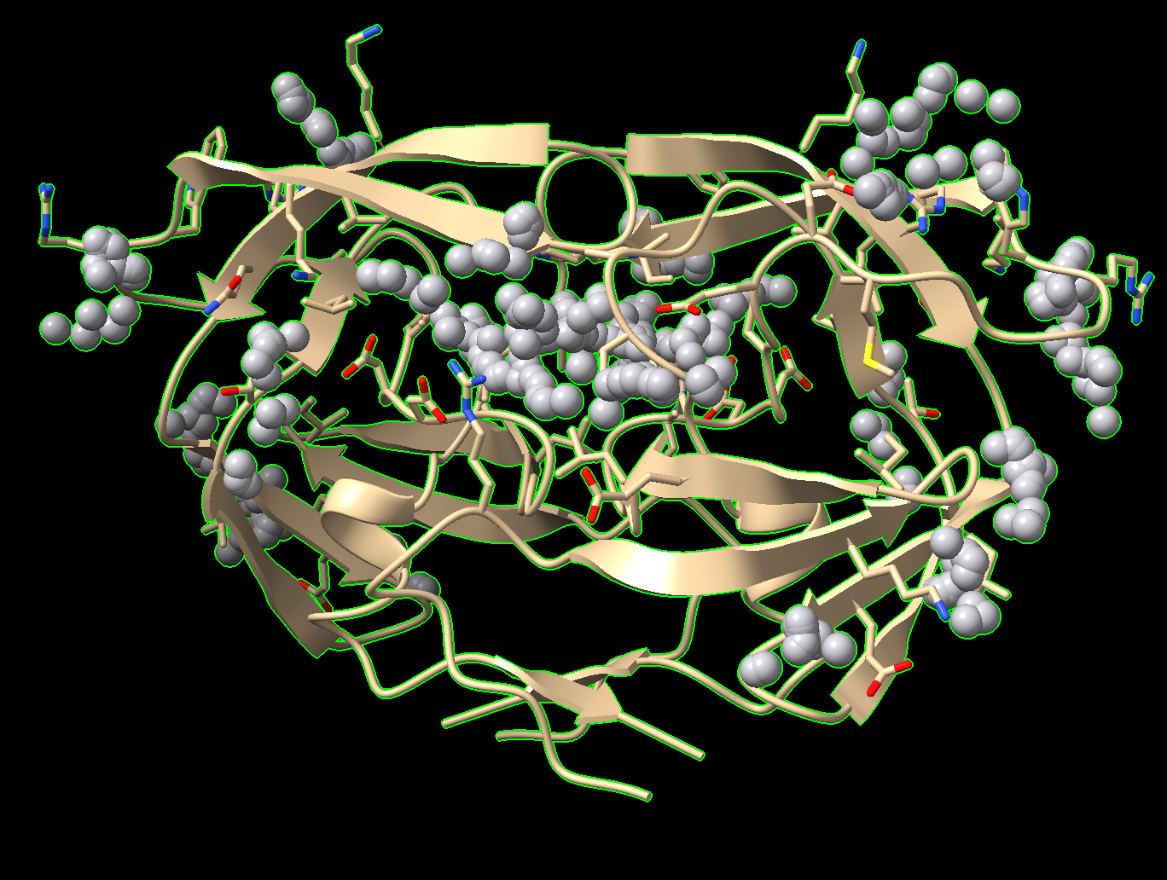
Cavity detection in proteins
pyKVfinder (from ChimeraX)
Fpocket (more precise) https://pmc.ncbi.nlm.nih.gov/articles/PMC6791542/)

Slide 48
Docking prep
Chimera dockprep
To select centre of the cavity: measure center sel
View centroid: define centroid sel radius 2 color orange

Slide 49
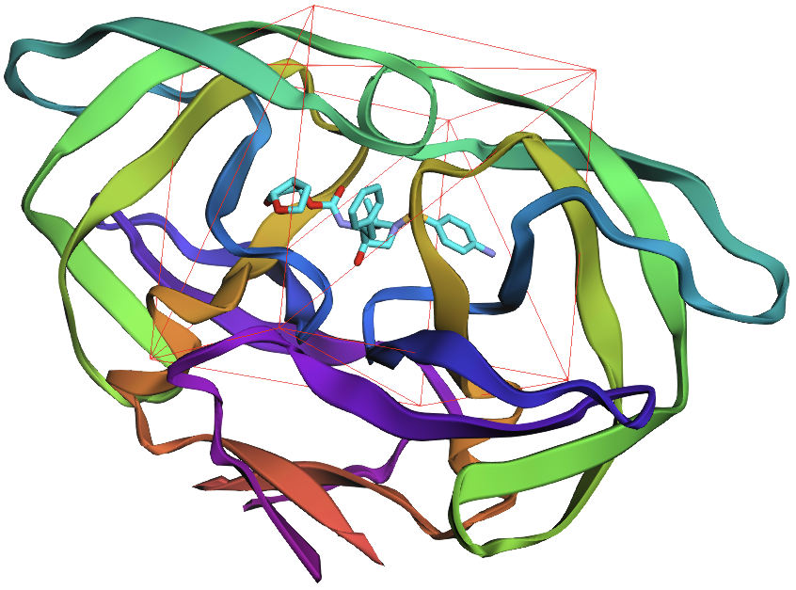
Affinity maps through docking box
Defining the search space within the receptor for docking tools to test ligand conformations

Slide 50
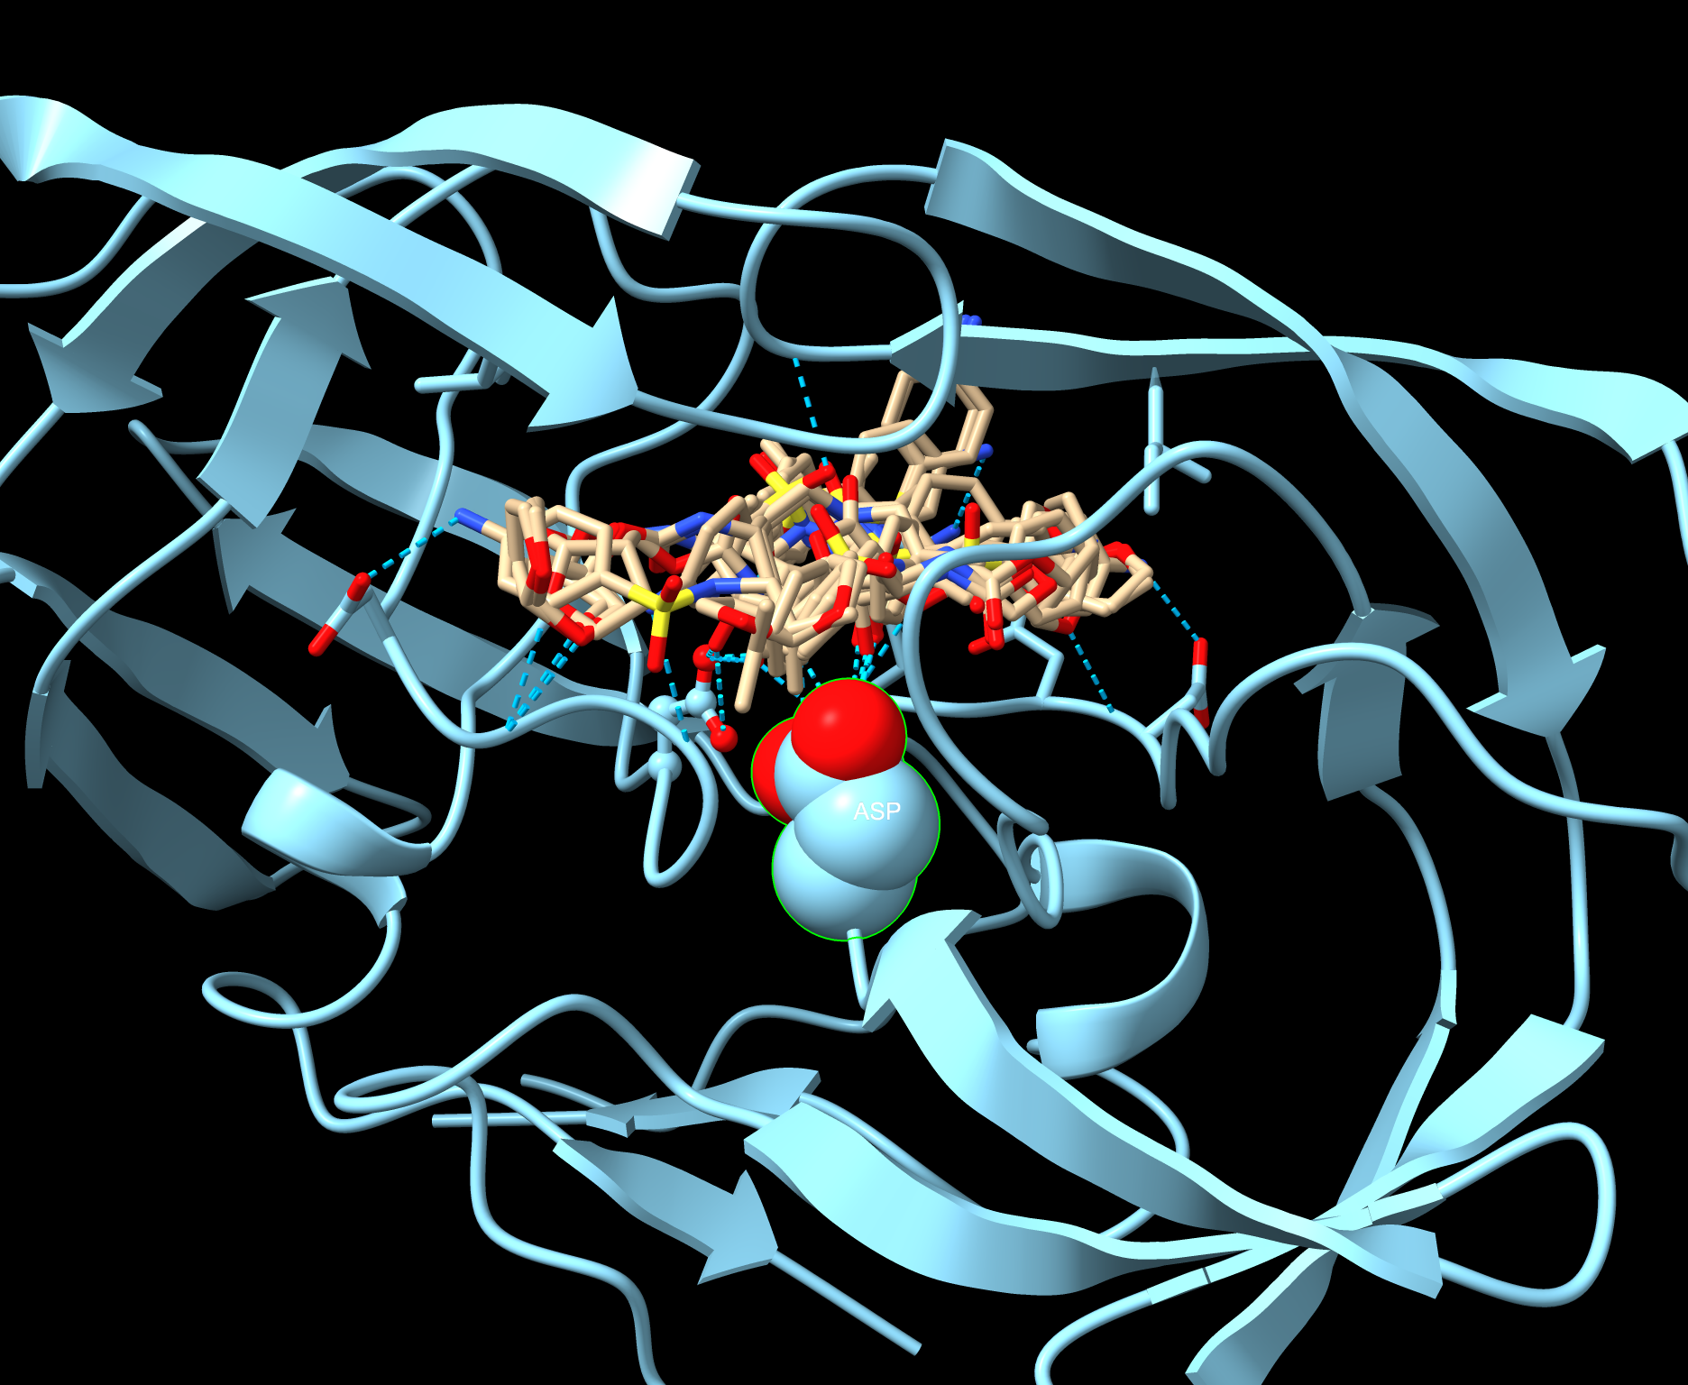
Docking – Different ligand conformations

Slide 51
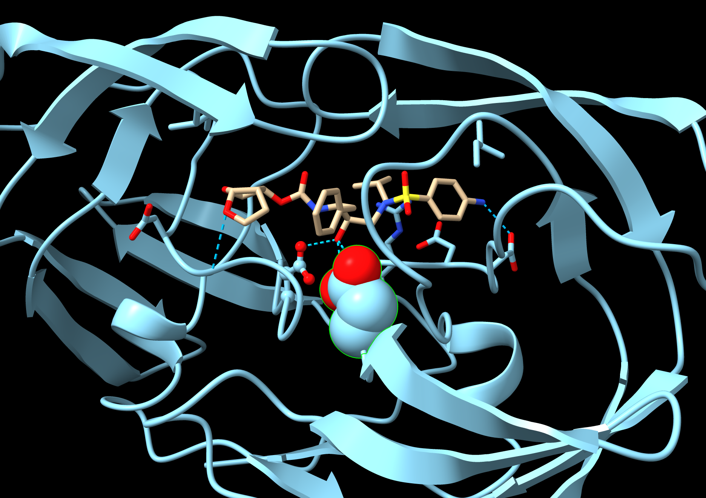
Docking Poses – Best poses

Slide 52
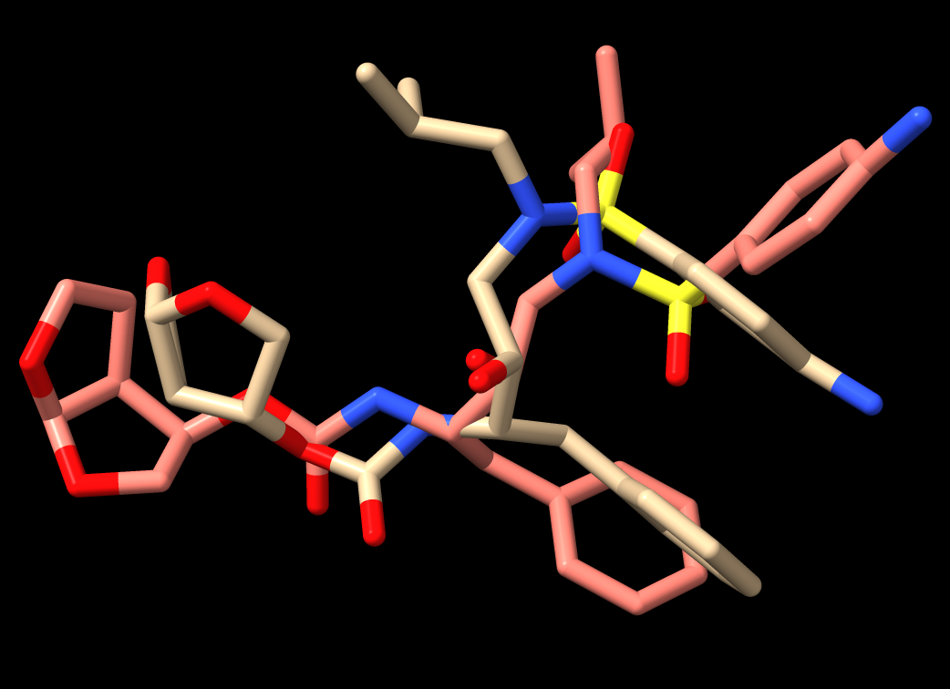
Comparision of docking pose with x-ray cryst structure
RMSD: 2.7 Å

Slide 53
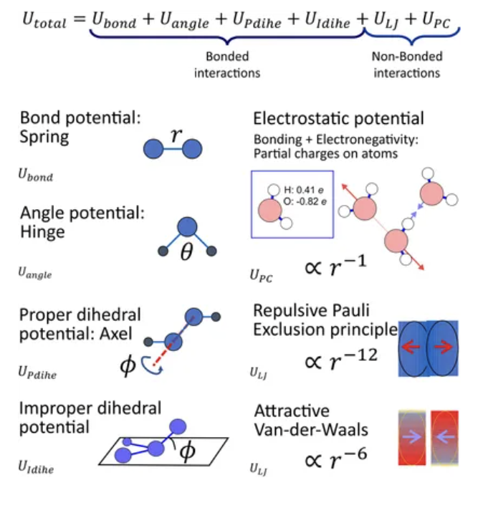
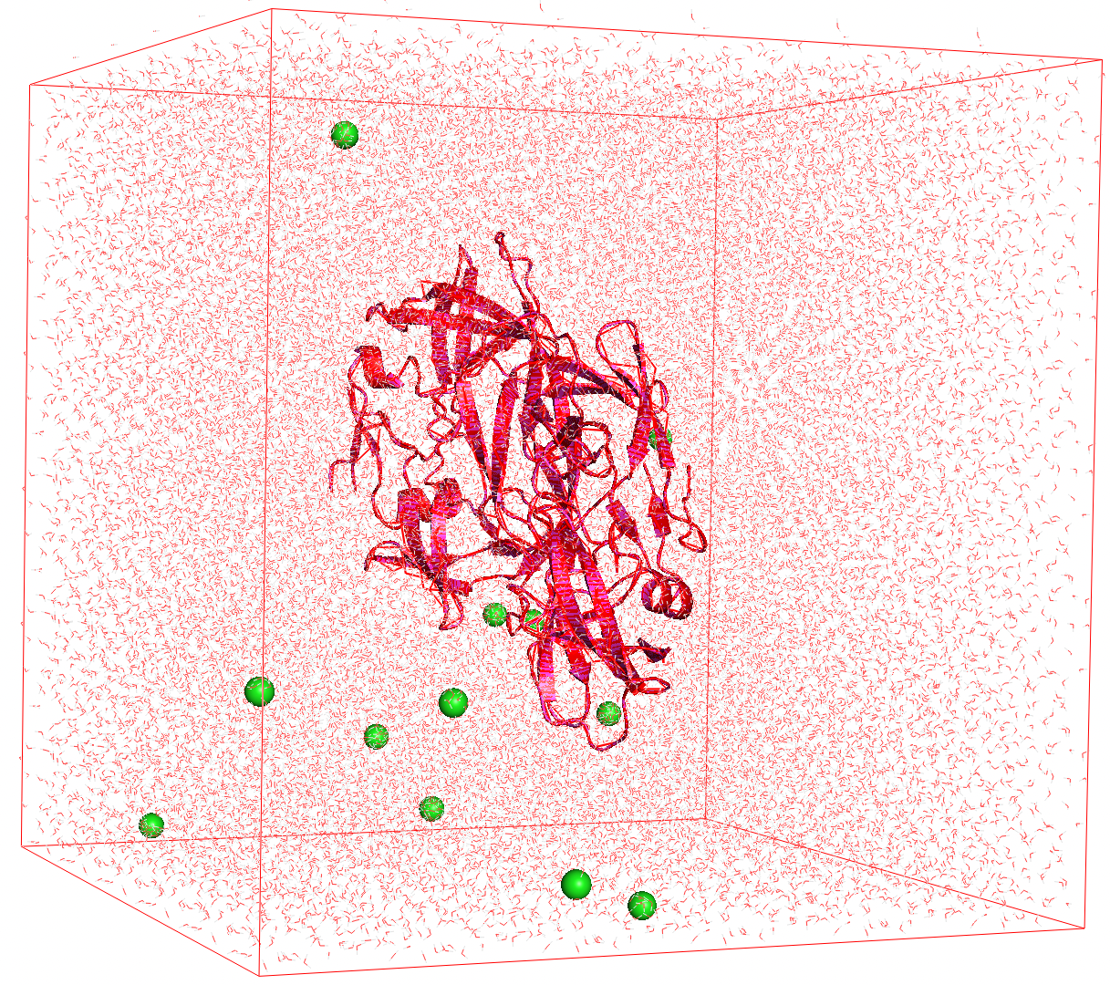
Molecular dynamics simulation
https://www.compchems.com/setting-up-a-molecular-dynamics-simulation/#system-preparation
https://www.frontiersin.org/journals/molecular-biosciences/articles/10.3389/fmolb.2020.604770/full
Interactions considered during MD runs

Slide 54
Any questions? ☺
SHORT BREAK

Slide 55
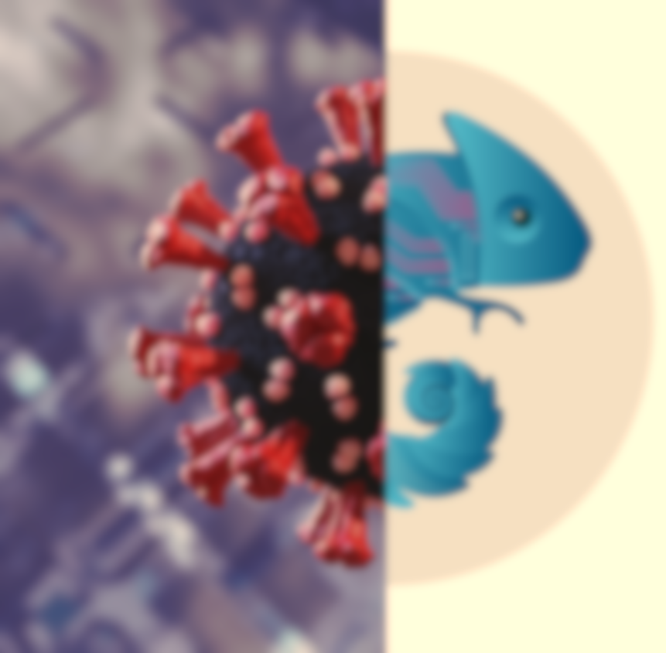
Summary
Novel mutations and mutation combinations which correlate with disease outcome
Scalable variant tracking pipeline that can automatically process genomic data, identify significant SNVs and combinations, and perform protein modelling
Analysis hampered by lack of clinical annotation – call for better regulation of data collection
Caveats; - sampling bias due to only a small portion of dataset used - need for in-vitro and in-vivo assays - no consideration for patient demographics (age, sex, pre-existing health conditions)

Slide 56
Future and ongoing work in the group
A “plug-and-play” end-to-end pipeline for genomic surveillance of any pathogen – looking at automating protein folding
Can be used as an adjunct to help (not replace) expert panel assess a variant for VOC/VOI designation
Need for dataset with host whole-genome and pathogen whole-genome sequences – cross species interactions
SynerOmics; detects interactions between many types of ‘omic data

Slide 57
Tomorrow?
PathsBeacon
Panel & Networking

